Slide 1


Data Integrity and Security
in CAN-Communication
Bassel Alnabhan Daniel Granér Magnus Kristiansson

Slide 2
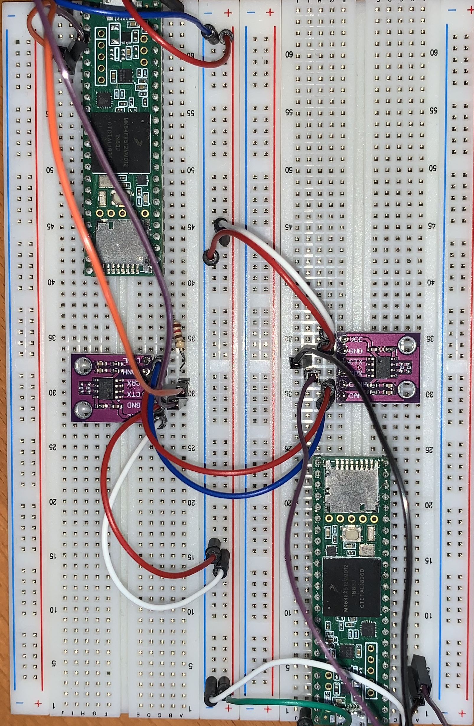

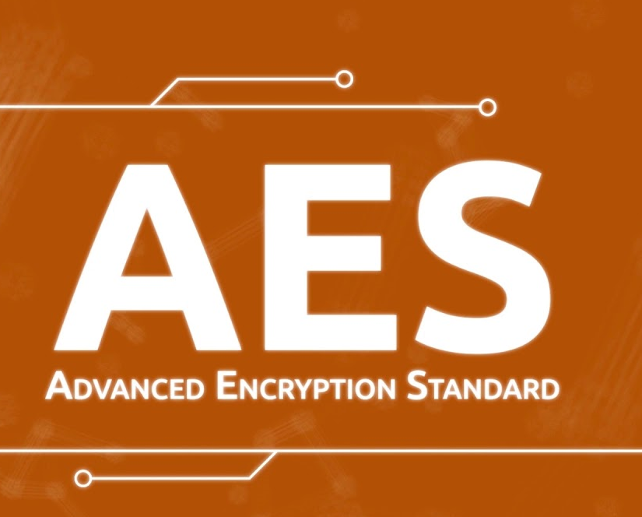


What we have done

Slide 3
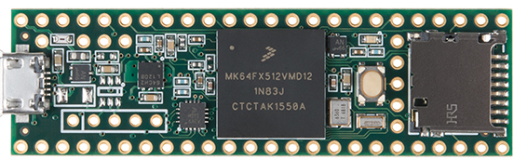
How it works
Login
Login response
Task Request
Task response
Authentication request
I am the client
HT-3557
YA.HT-3557.ya
I YaAm .HtTh-e 35c57l.iyenat
I YaAm .HtTh-e 35c57l.iyenat&HSG#¤#%KAND(KD4NS23
?23DHD%E#(”¤JD#KS23#¤2Wj2EI9kejk
7JEO#¤”DEKen#=32729jb3e”#)7dnsd8
7JEO#¤”DEKen#=32729jb3e”#)7dnsd8.HAS83#U)MS28O2)209HS
Client
Server

Slide 4
How it works
Login
Login response
Task Request
Task response
Authentication response
Bad request
Generate AES-key and Session ID, start session timer
Client
Server

Slide 5
How it works
Login
Login response
Task Request
Task response
Ask for the temperature
Client
Server

Slide 6
How it works
Login
Login response
Task Request
Task response
Respond to temperature request
Read the temp, encrypt AES and send
Not authenticated
Bad request
Client
Server

Slide 7
Thanks

